Slide 1

IS362 Final Project
Using Decision Tree to Predict Heart Diseases
Victor Guandique

Slide 2
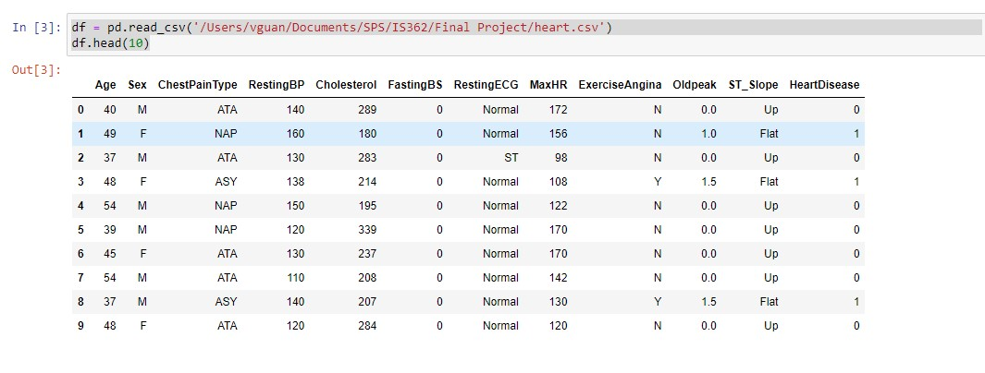

Data Set
The data set used is Heart Failure Prediction from Kaggle
This table included a total of 918 rows and 12 columns one of the more difficult decisions was to decide which fields to use to do the predictions.

Slide 3
The reason to choose this data set was because there is a lot of people suffering and dying from heart diseases every year not just in the US but around the world. Trying to find signs or symptoms that help to predict them is very important to prevent or provide the necessary treatment on time. This will help to reduce the number of people dying due to heart diseases.

Slide 4
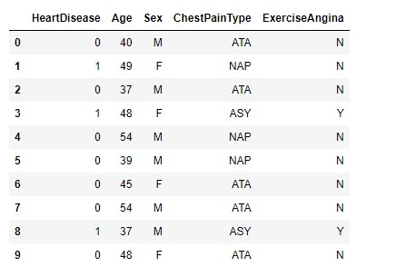
I chose 4 fields to predict heart diseases. This fields were combined.
The combinations were Sex and exercise Induce Angina as first option and the second option was Age and Chest pain Type.

Slide 5
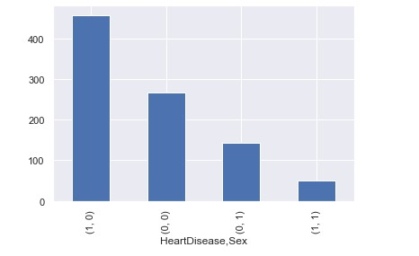
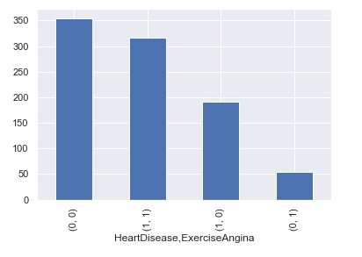
Sex and Exercise Induce Angina

Slide 6
A decision Tree was used to make the predictions. The accuracy of using Sex and Exercise Induce Angina to predict Heart Diseases was 57%
57.065217391304344

Slide 7
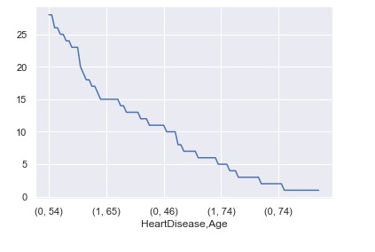
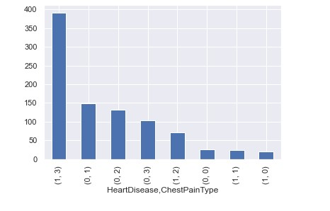
Age and Chest Pain Type

Slide 8
A decision tree was also used to predict heart diseases using age and chest pain type. The accuracy of using age and chest pain type to predict heart diseases was 73.37%

Slide 9
Based on the prediction analysis there is a higher accuracy of predicting heart diseases using age and type of chest pain. More research is necessary using other fields from the data set either individually or combined

